Slide 1
Atliq Grands

Slide 2
Introduction
Atliq Grands owns multiple five-star hotels across India. They have been in the hospitality industry for the past 20 years.
However, due to ineffective decision-making in management, Atliq Grands are losing its market share and revenue in the luxury/business hotels category.

Slide 3
Details of Data
April
May
June
July
Booking Months

Slide 4
Main KPIs
Revenue – Total Revenue Realized
Total Bookings
Average Rating
Total Capacity
Total Successful Bookings
Occupancy % - Ratio of Total Successful Bookings to Total Capacity
Total Cancelled Bookings
Cancellation Rate - Ratio of 'Total Cancelled Bookings' to 'Total Bookings'

Slide 5
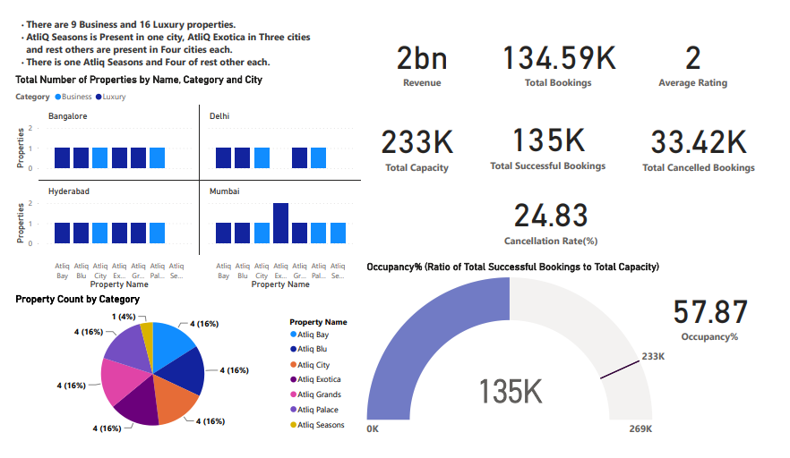
AtliQ Hospitality Analysis

Slide 6
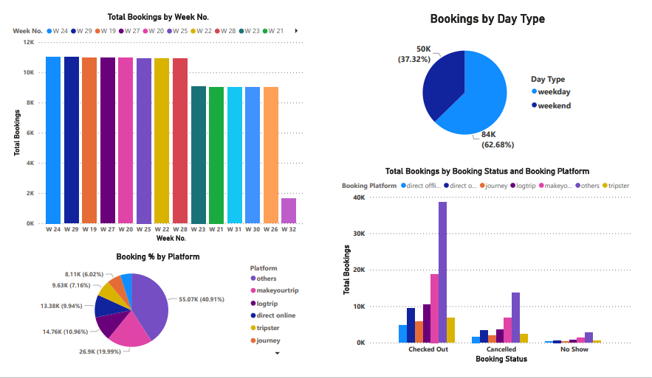
AtliQ Hospitality Analysis

Slide 7
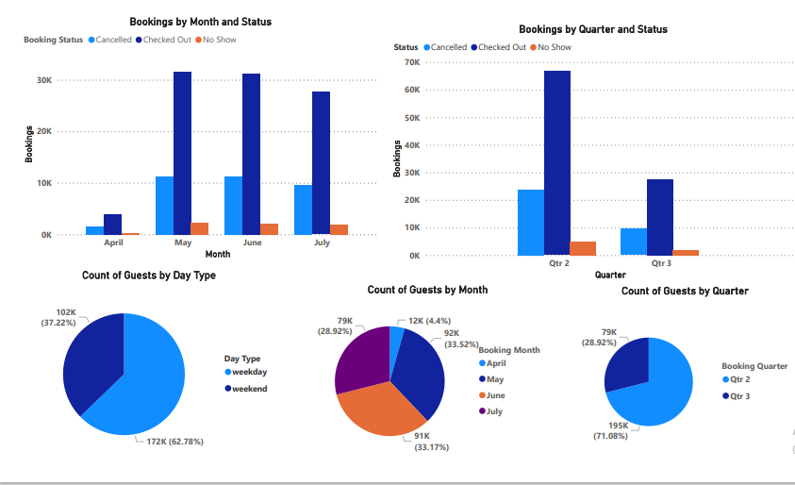
AtliQ Hospitality Analysis

Slide 8
Thank You

